Slide 1
My Sisters
A 14-page comic story about Indigenous basketry. Written by Chag Lowry (Yurok/Maidu/Achumawi) and Weshoyot Alvitre (Tongva) with art by Weshoyot Alvitre. Published by Original Voices.

Slide 2
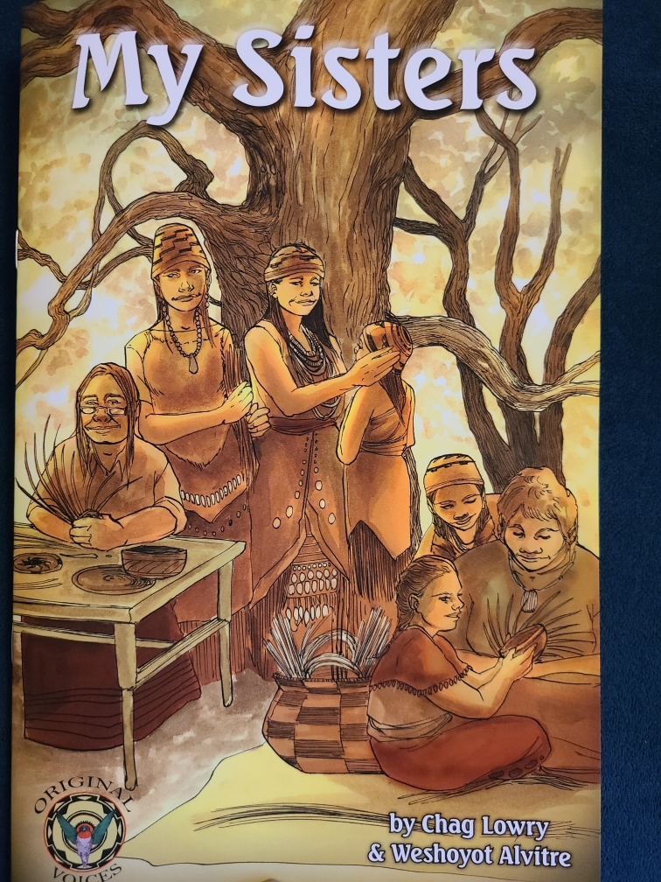
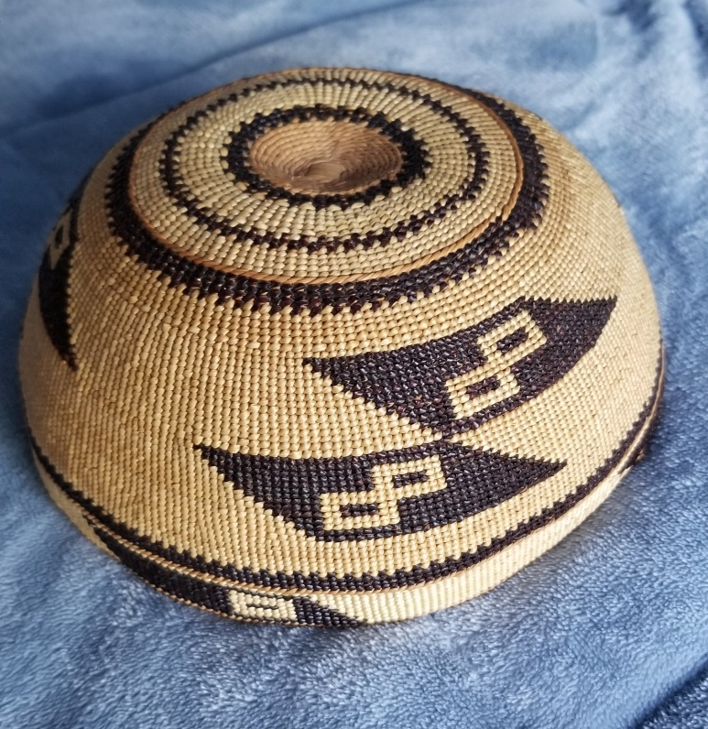
My Sisters honors the special relationship that basket weavers have with their homelands in this unique story told through the perspectives of the baskets themselves.

Slide 3
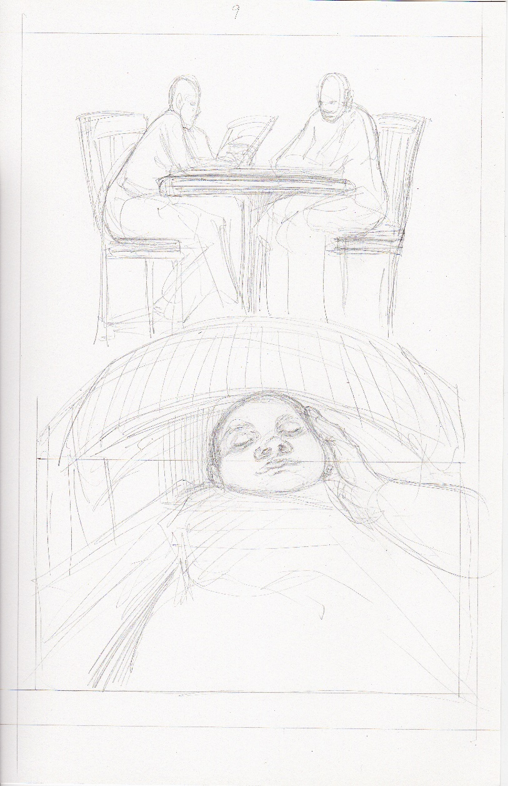
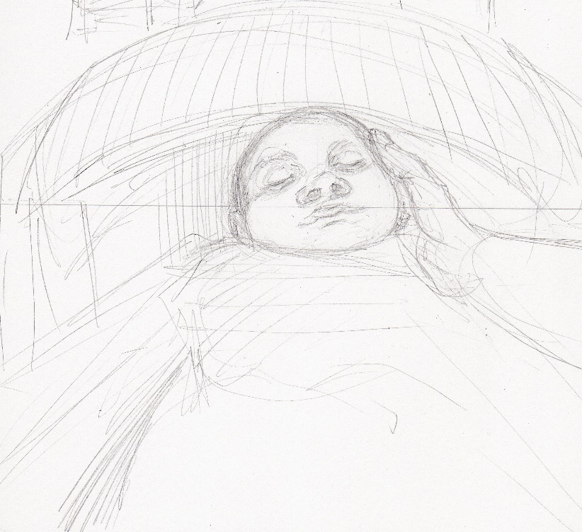
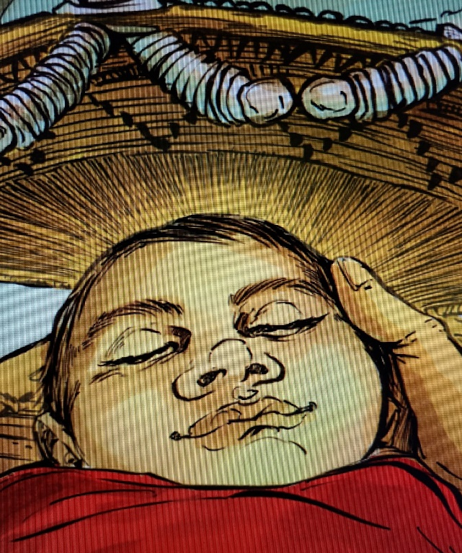
The process to create this book had several stages. First, the script was written. Second, the artist created thumbnails of every panel on every page according to the script. Third, the artist pencils the layout of each panel on every page.

Slide 4
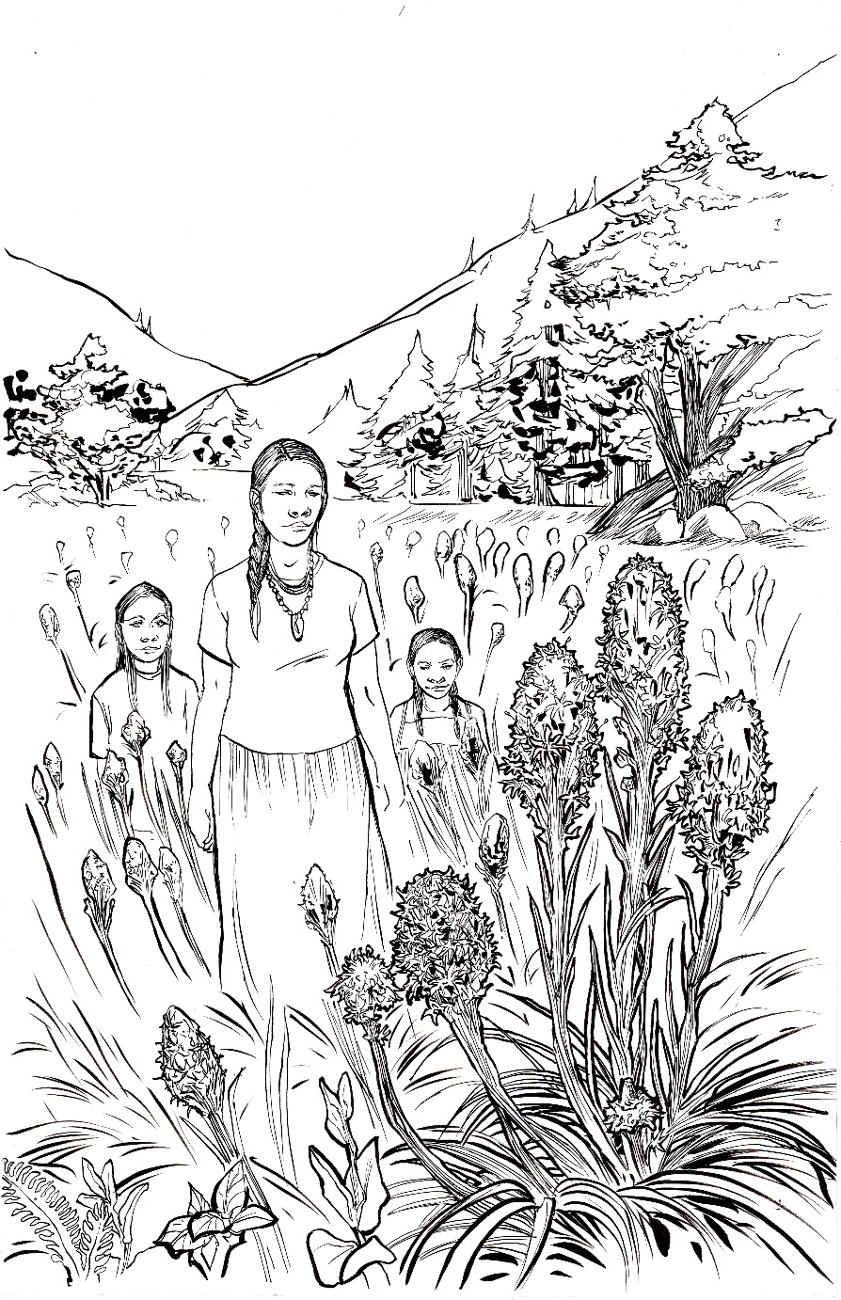
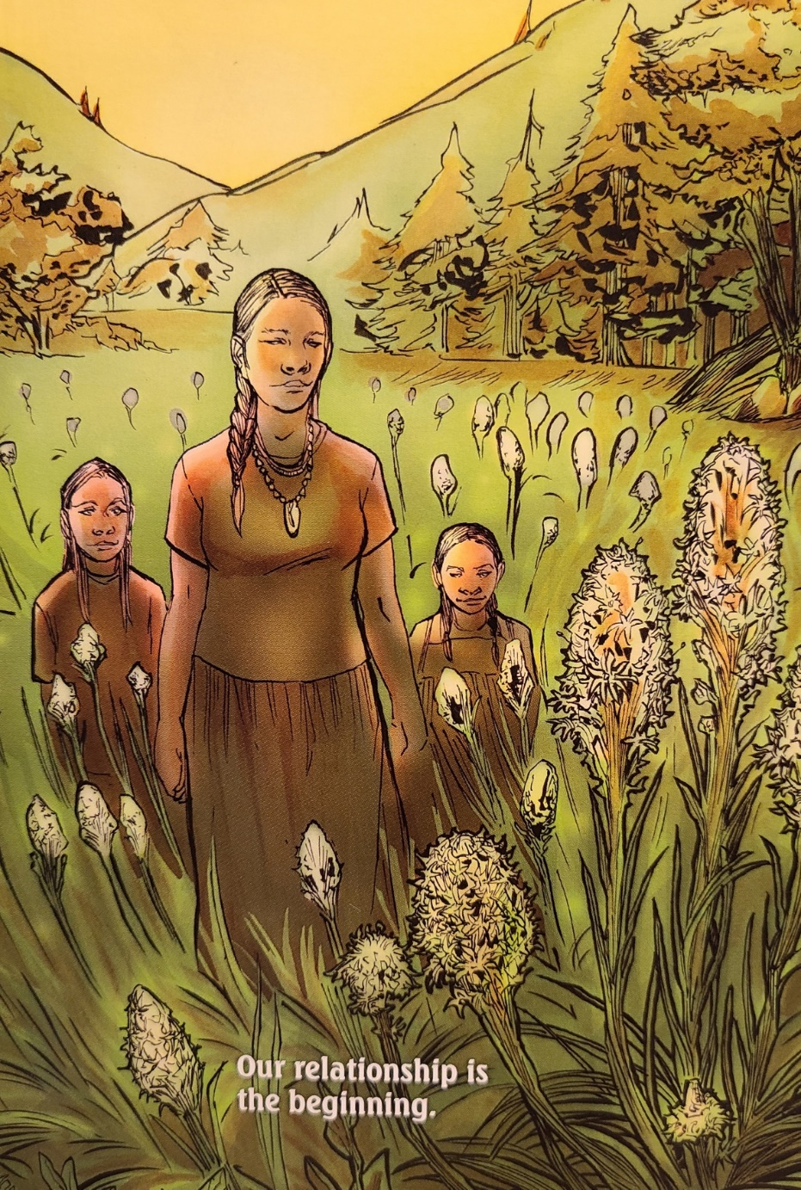
The fourth stage was when the artist inked the penciled work. The fifth stage was when the artist colored every panel. After this, the images are sent to the graphic designer to be lettered and the comic is designed. After a final edit, the comic is printed.

Slide 5
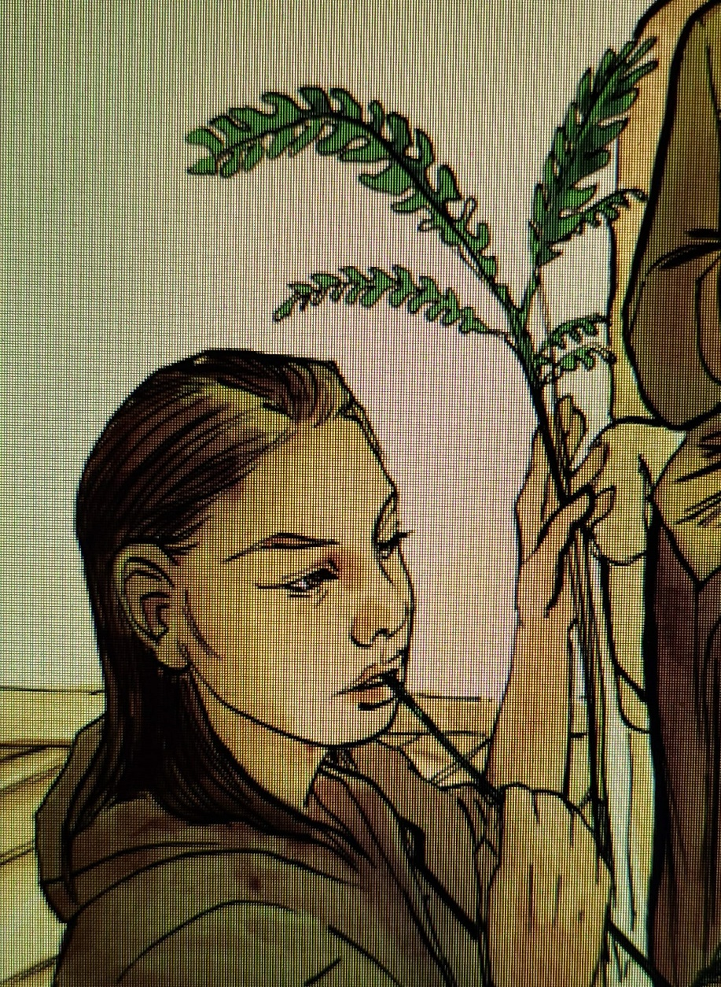
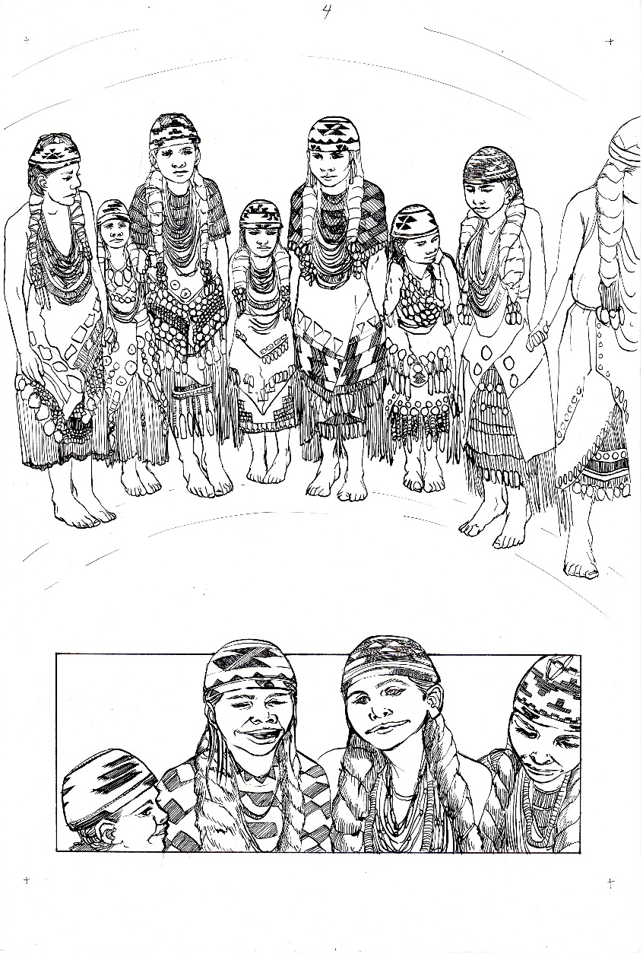
Native women and girls are at the center of this story. The relationship with the basket and basket materials are viewed through their eyes and on their faces in this comic. I wrote my pages as if the baskets or the basket materials were speaking. A reader can also perceive it as if the human characters are the narrators.

Slide 6
Weshoyot wrote the three Tongva pages. The Tongva are the original people of the L.A. region. Weshoyot is an amazing artist and her IG is @weshoyot

Slide 7
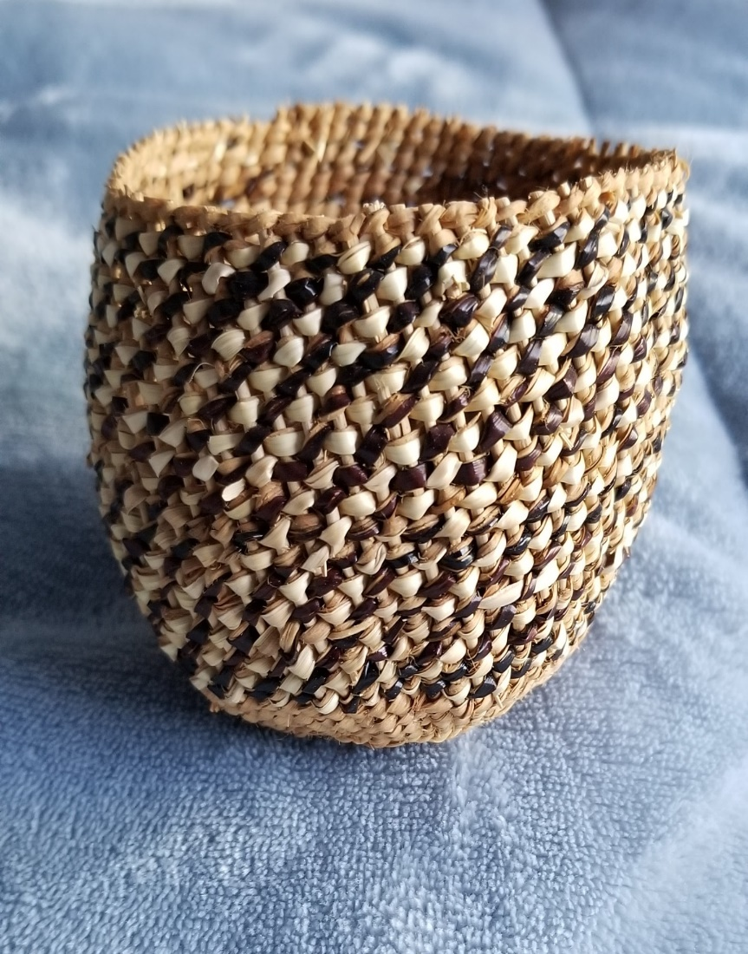
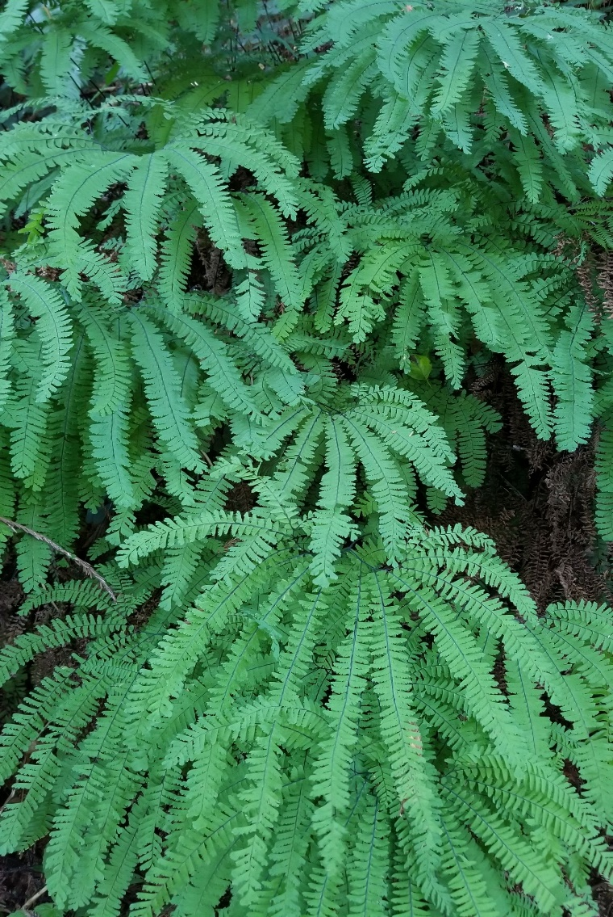
https://ciba.org/

Slide 8
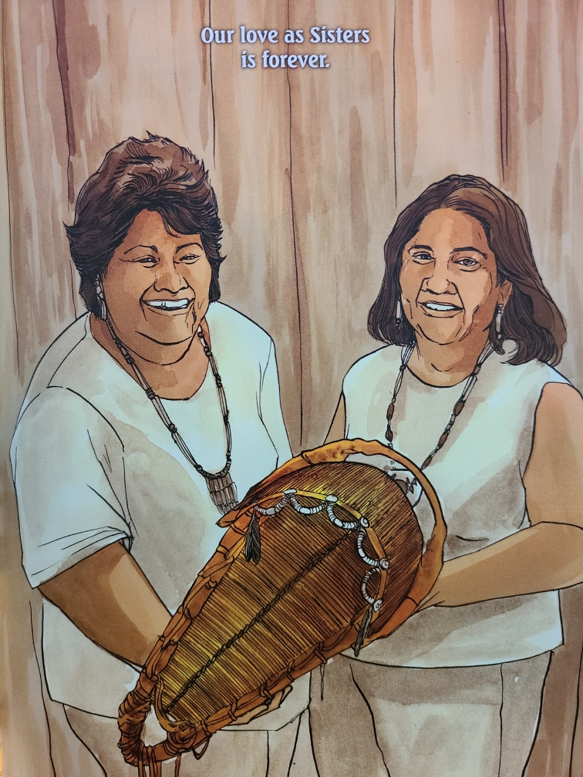
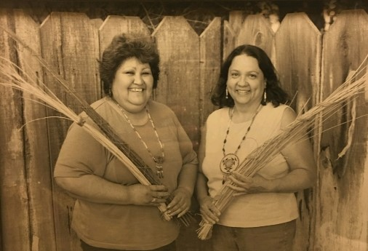

Slide 9
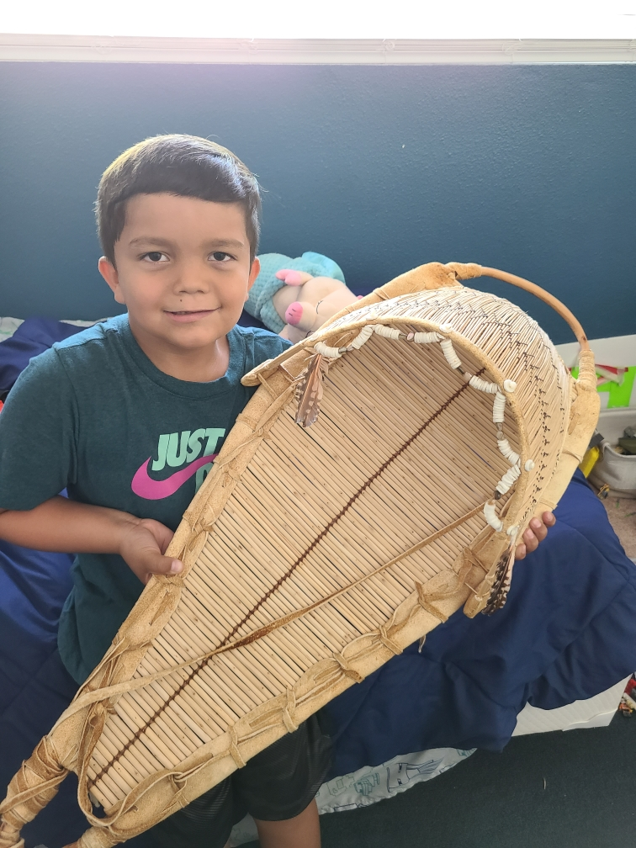
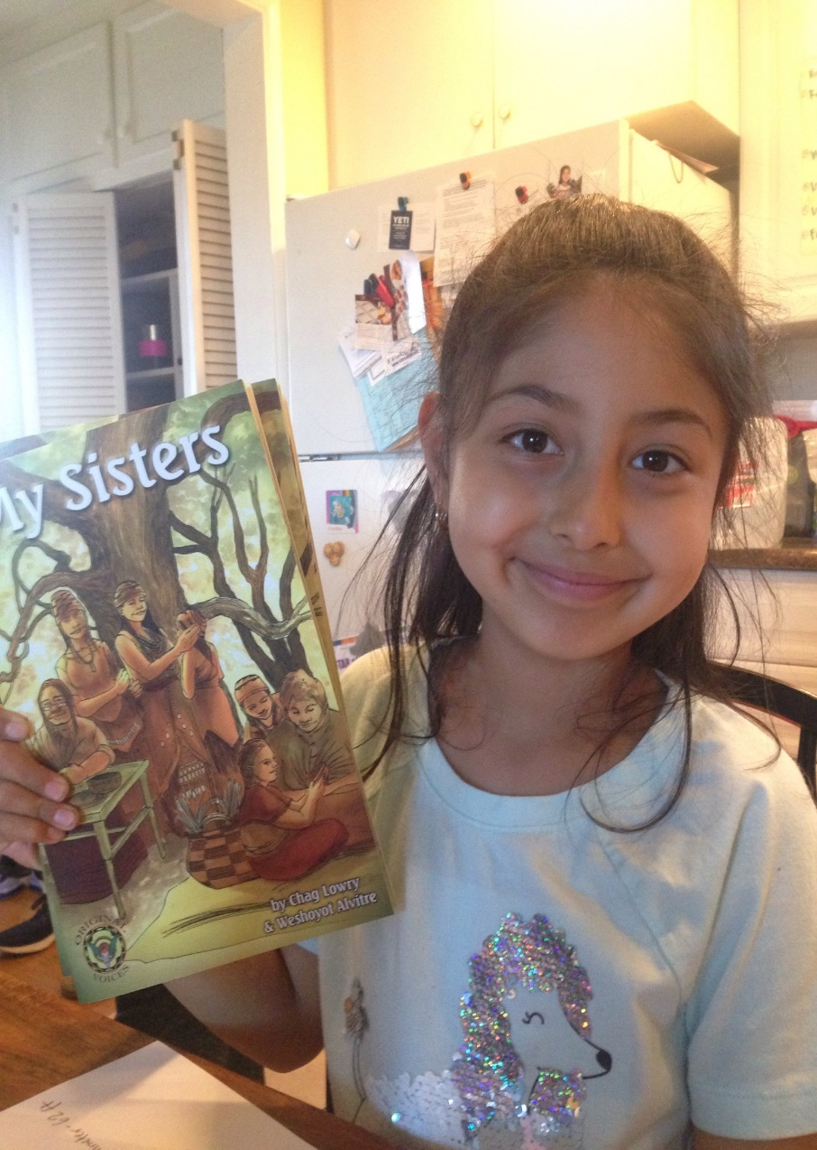

Slide 10
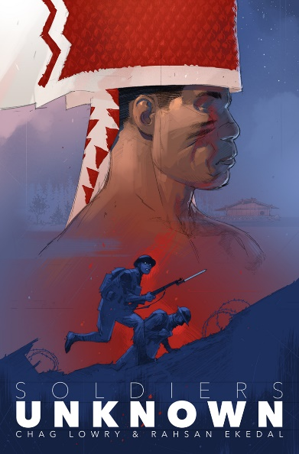

Slide 11
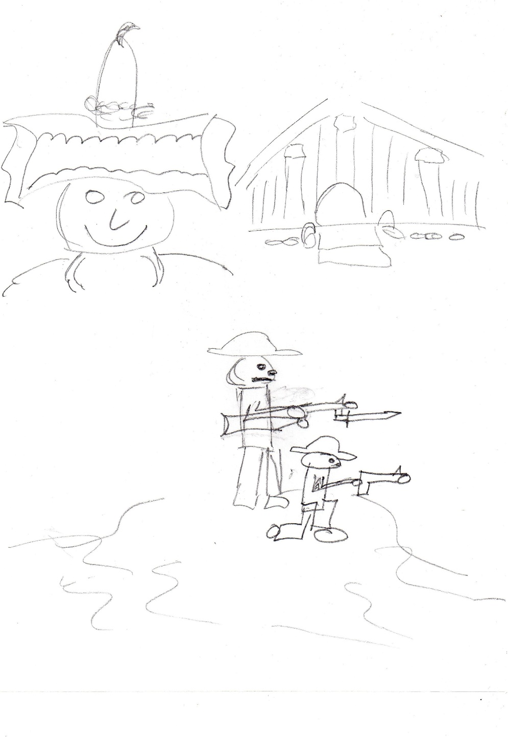
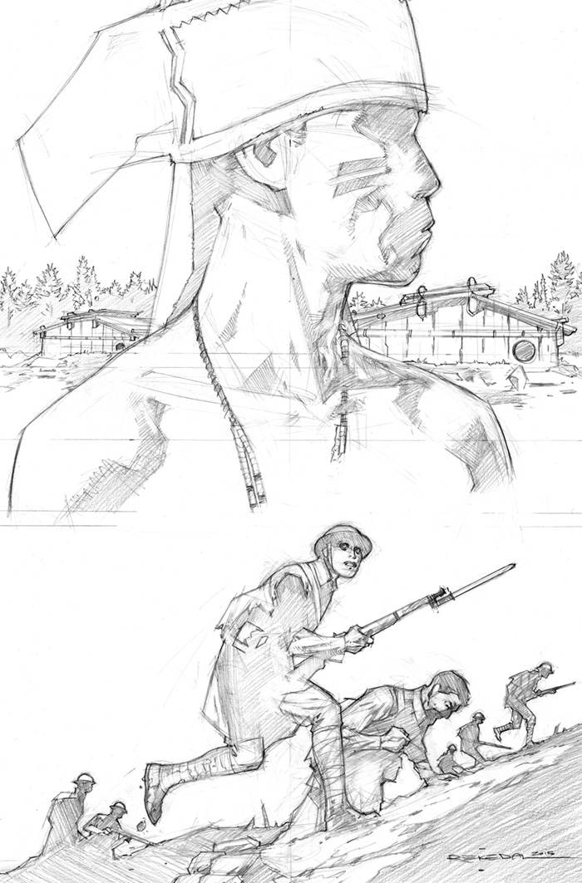

Slide 12
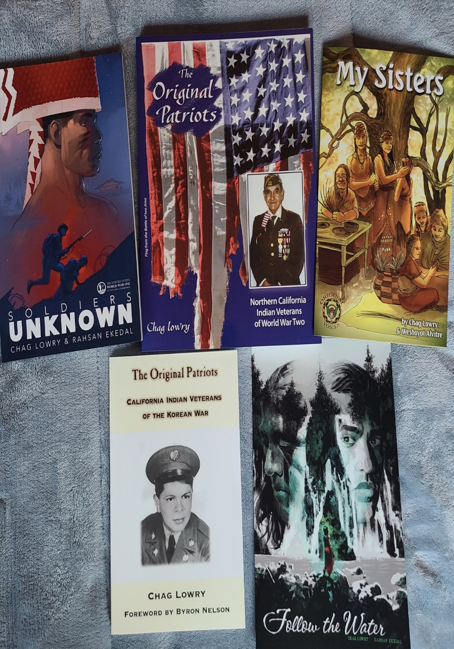
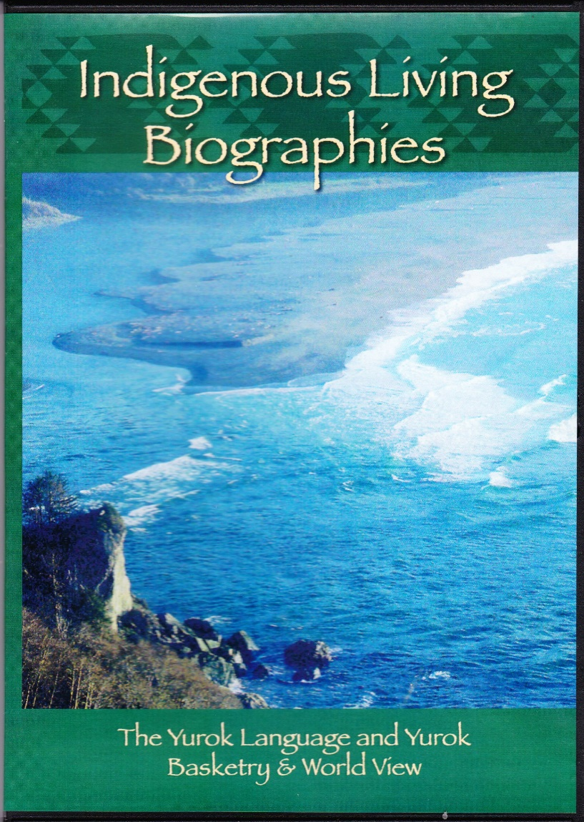

Slide 13
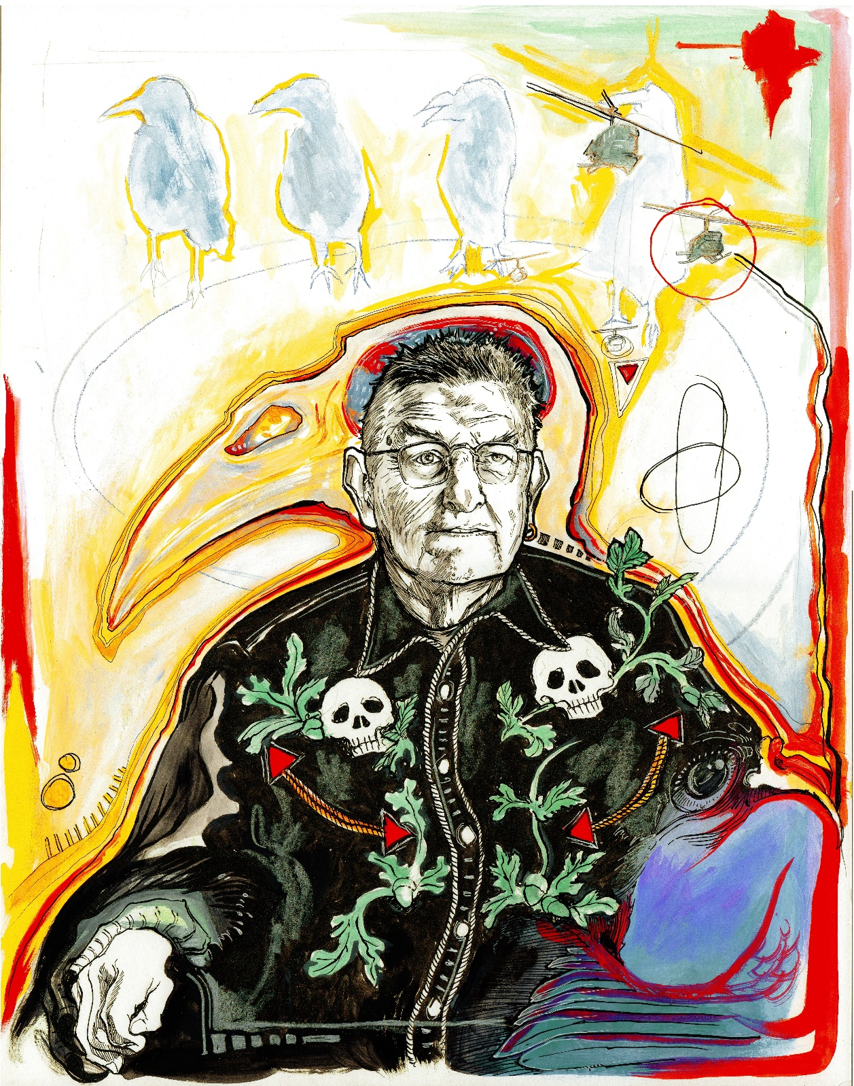
“Coming Home” a film about Wiyot artist Rick Bartow directed by Chag Lowry with videography by Melvin Cannon (Kumeyaay). Coming in February, 2022. In collaboration with Dell’Arte International.
Concept art of Rick Bartow’s journey by
Weshoyot Alvitre (Tongva).

Slide 14
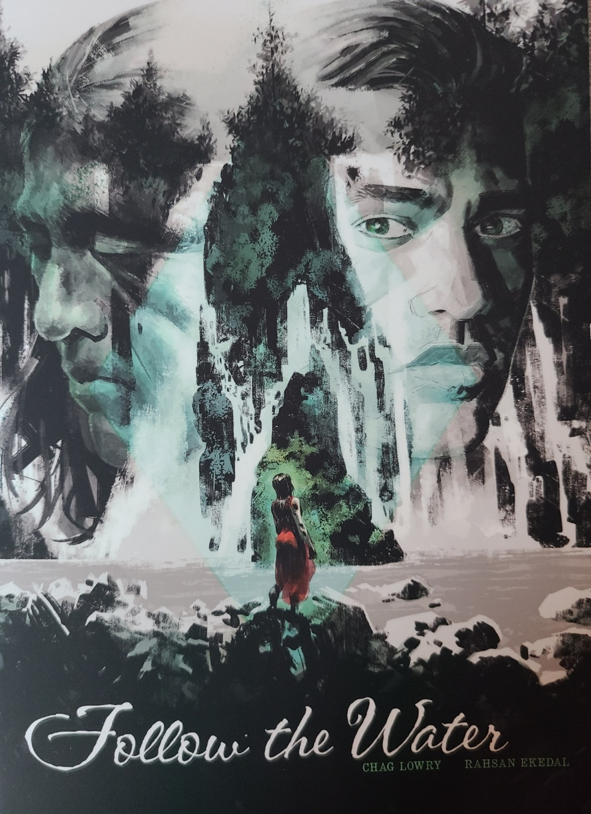
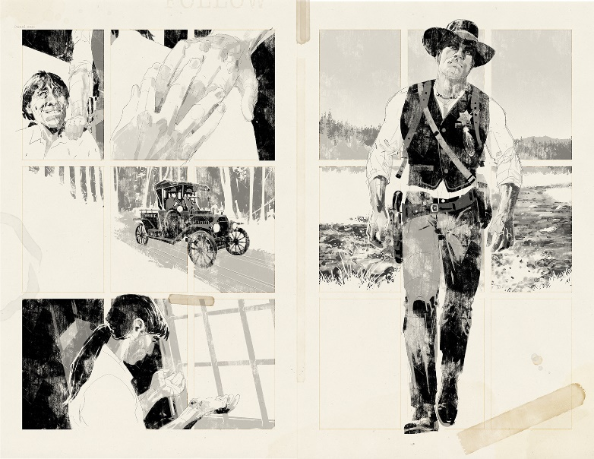

Slide 15
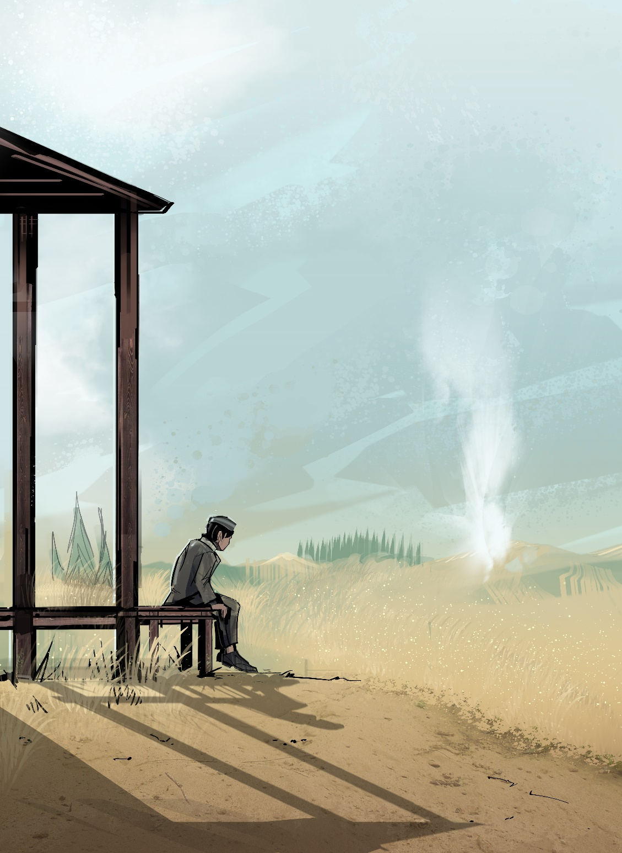
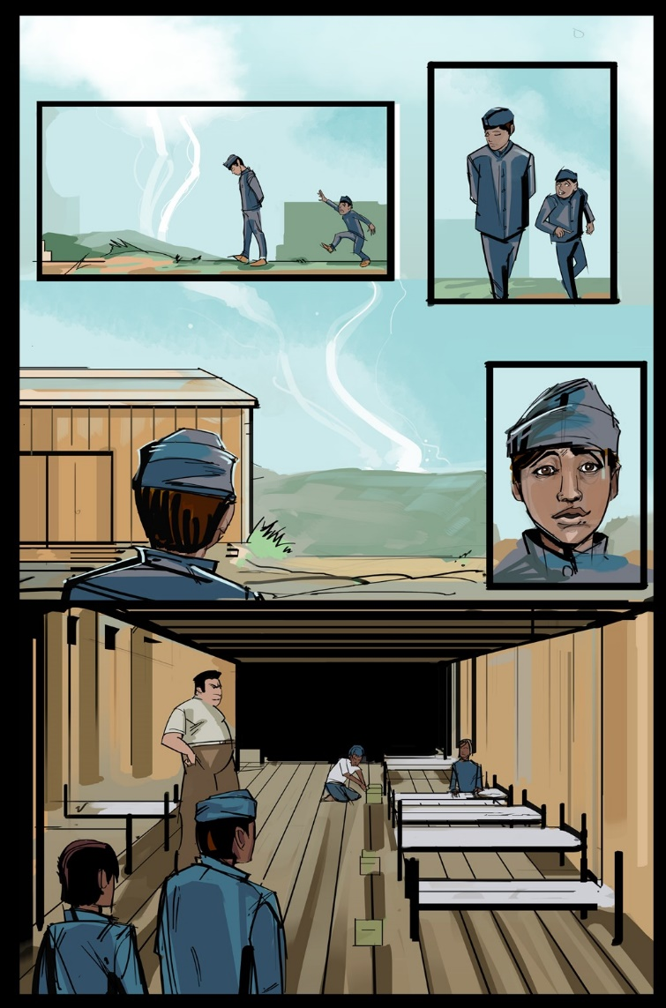
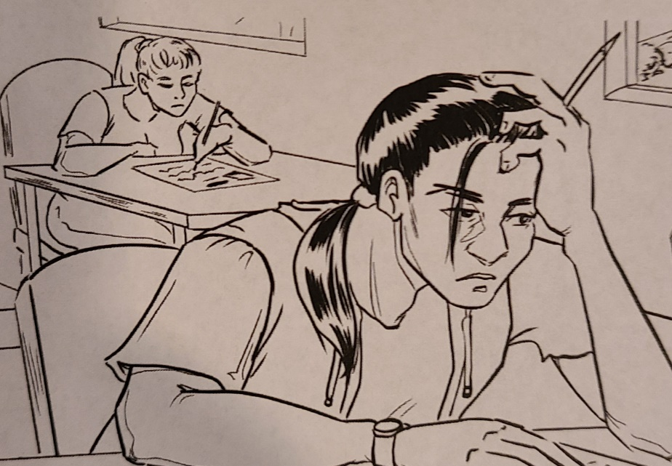

Slide 16
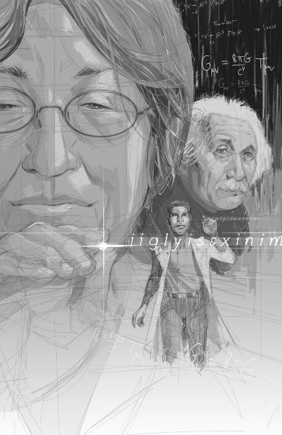
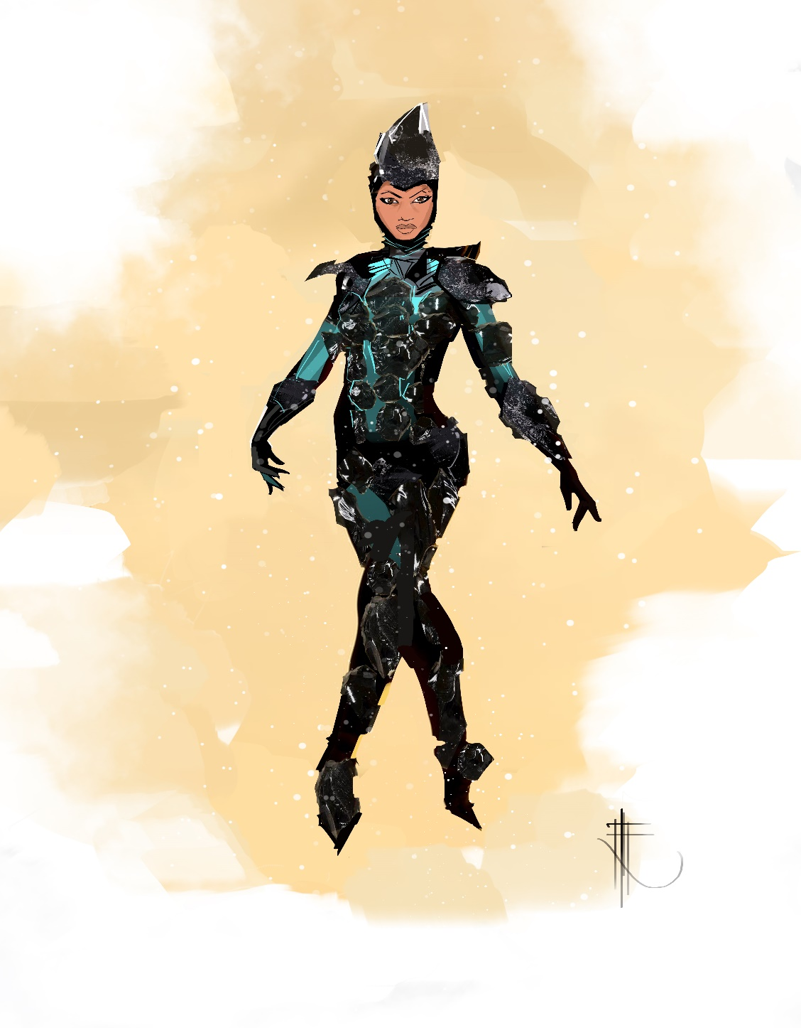

Slide 17
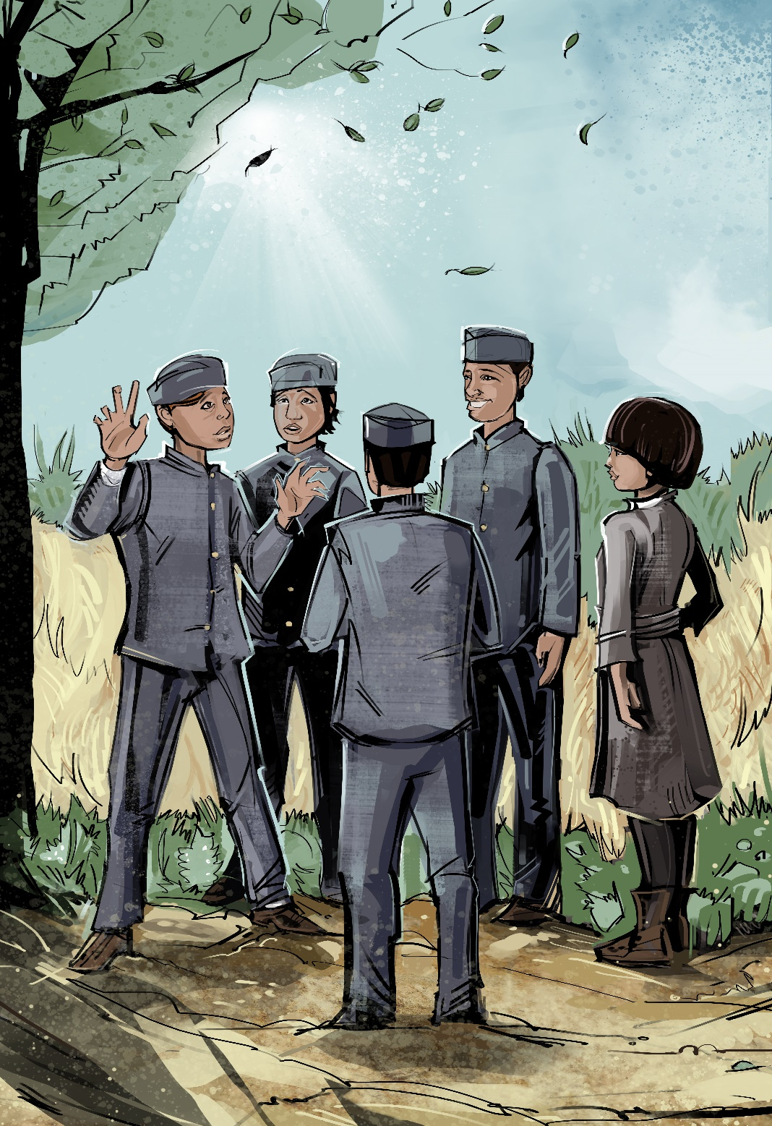
Please go to www.bluelakerancheria-nsn.gov/pathmakers/chaglowry/ to access free CA standards-based curriculum that correlates to each comic story that was created by Rebecca Lowry. There are also three short video clips of me sharing about my creative process to make comics. Special thanks to Blue Lake Rancheria and their Tribal Council for supporting this curriculum work and my stories.
Thank you to College of the Redwoods and to Alia Dunphy, Director of Student Equity and Success. Thank you to all Indigenous Basket Weavers for your dedication and love for your people and your homelands.

Slide 18
