Slide 1
BLR Climate Resilience Internship

Slide 2
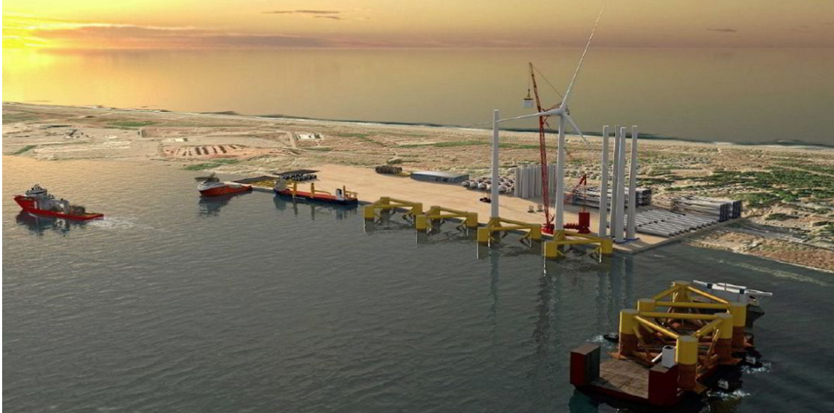
My name is Kyle Spears I am a senior at Cal Poly Humboldt majoring in ESM energy and climate. I am interested in the world of renewable energy. This has been a big focus of my studies and the field I want to go into upon graduating. Specifically working with microgrids or wind energy.

Slide 3
Role and Funding
Role of Intern
-Updating the tribes Climate Action Plan
Funding for the internship
-A grant from BIA through the Tribal Climate Resilience Program
Notes:
utilizing information and data from the Tribe’s existing climate planning documents, Multi-Hazard Mitigation Plan, tribal climate adaptation planning guidance, and research from credible sources.
The idea of the reliance internship is to have students gain experience through the summer working on updating the CAP. The program is funded for multiple years for several interns each summer.

Slide 4
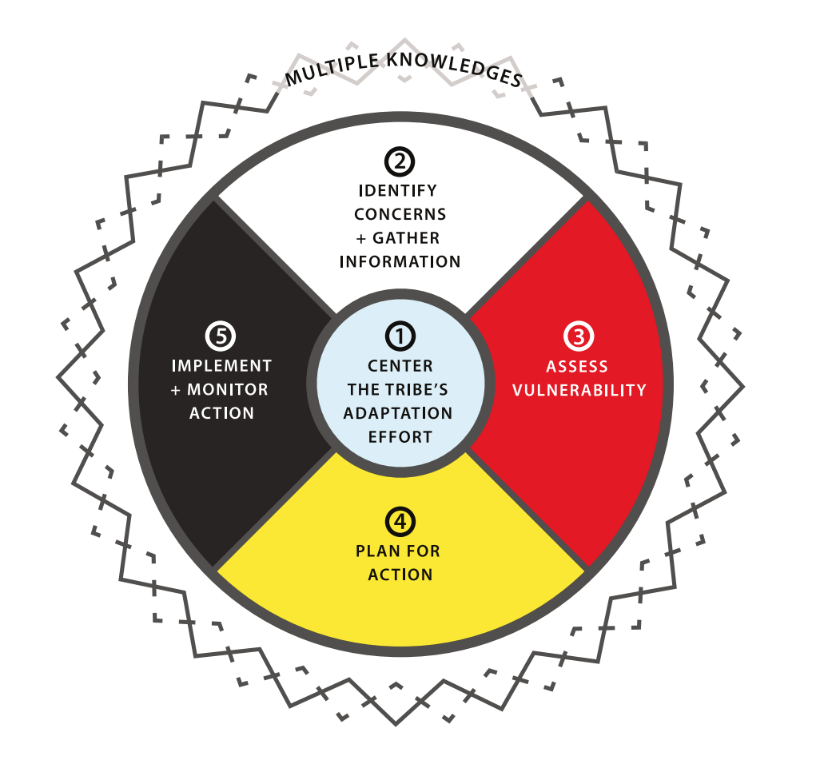
What is a CAP?
Purpose of a CAP
-Outline the impacts climate change will have on a
local environment
Uses of a CAP
-Guiding policies, efforts and resources
Notes:
Purpose
-The purpose of a climate action plan is
to outline the impacts that climate change will have on local environments. Determining the
vulnerabilities to the areas of focus and the projected effects climate change will have on them.
Developing goals and actions to address the vulnerabilities from climate change.
Uses
-Developing goals and actions to address the vulnerabilities from climate change to the local region and community. It will be used to develop policies to adapt the community to the changing climate. Through guiding efforts and resources to mitigate the effects of climate change. Guiding policies to move towards a
sustainable future. It will help communities to seek out and receive funding to help mitigate the adverse impacts of climate change. The goal is resiliency.

Slide 5
Differences of a tribal CAP
Tribal CAP’s include traditional knowledge
Interconnectedness with the ecosystem
Ecocultural restoration
Notes:
-TK from observations of generations of indegneous peoples being stewards of the land.
- Tribal CAP’s from my research treat the environment and the changes from climate change with respect to the ecosystems as they are a part of it. Where traditional government CAP’s seem to see themselves as the center of focus. Tribal CAP’s discuss more of the impacts on the environment and how they can lessen the impacts of areas that weren’t always discussed in other government agencies such as fisheries, stream and creek restorations, or of native species cultural significance
- A term I came across that I thought showed the way many of the tribal CAP’s i research was A term from a discussion of the “ecocultural restoration” from a House hearing tribal perspectives on youtube. This term describes the symbiotic relationship of ecosystem health and human health. Demonstrating the often regenerative mindset of tribal CAPs.

Slide 6
CAP Expectations Research
My research started with developing an understanding of what a tribal CAP entails.
Examples of tribal CAP’s
Karuk
Ute Mountain
CSKT
Notes:
-Reading through multiple tribal CAP’s and guidelines I gathered an understanding of what is expected in a CAP. One of the best guidebooks from my research was on published by oregon state. It walked through the general sections and recommendations for people in my position looking to get started in the world of CAPs.
-There were multiple tribal CAP’s I read through to further gain an understanding and an example of what was expected. Several that stood out to me were the Karuk(mid klamath river) tribal CAP, the Ute mountain(colorado) Tribal CAP and the Confederated Salish and Kootenai Tribes(montana). All provided an understanding of what a Tribal CAP is and how to focus a tribal CAP. Demonstrating the difference in focusing of tribal and non tribal CAP’s
-Ute This one was interesting because the tribe is seeking out new fossil fuel power generation. The project is called Coyote clean power project and it is a natural gas power plant that allegedly emits zero carbon using carbon sequestration technology. It is supposed to lessen the burden of energy poverty while moving towards clean energy.

Slide 7
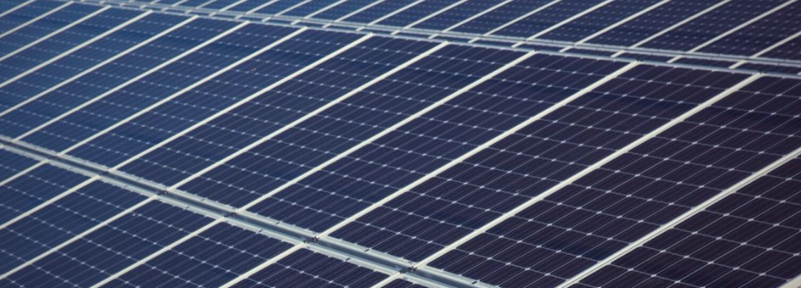
BLR CAP research
Researching specific impacts to the BLR region
Researching actions, steps, and policies BLR have took to mitigate impacts from climate change
Areas of Focus
Critical infrastructure including energy, communication, transportation, and water infrastructure.
Notes:
-Most of the climate science that I had compiled for the region came from the IPCC’s ar6 report and California’s fourth climate change assessment on the North Coast. These documents are developed through research from the top climate scientists and are peer reviewed to determine the most accurate assessments and predictions from models.
-Yes the next step included more research. This time is was getting into the actions BLR has took to work towards a more resilient future in the face of climate change. This meant picking focus areas to guide my research. Then seeking out documents and individuals who would be able to provide information necessary for my focus area. Documents from BLR that I used included the previous CAP, multi hazard mitigation plan, strategic energy plan, and tribal environmental plan. As well as dicussions with Michelle, Jana, Daniel, and Jason.

Slide 8
Specific Climate Impacts to BLR Infrastructure
The largest threat posed to the infrastructure from my research is the increased risk of wildfire.
Changes in precipitation and severe storms also pose a risk to this sector. More severe for transportation infrastructure.

Slide 9
Findings
BLR is a leader of energy infrastructure with the development and implementation of microgrids. Leading as an example for other tribal communities with their energy sovereignty.
Moving towards a resilient water infrastructure system with the development of the smart water grid and potential wastewater treatment facility.
Notes:
-There were many findings from my research. As an energy and climate major at Cal Poly humboldt these were two of my favorite takeaways. I think Microgrids will play a big role in the breakup with fossil fuels as an energy source and building towards a resilient future. The way that BLR is leading as an example with the development of their microgrids set a course for other tribal communities to gain energy sovereignty. As well as with the smart water grid implementation. These are important parts for tribal and other communities to further build sovereignty and energy resiliency to make a change.

Slide 10
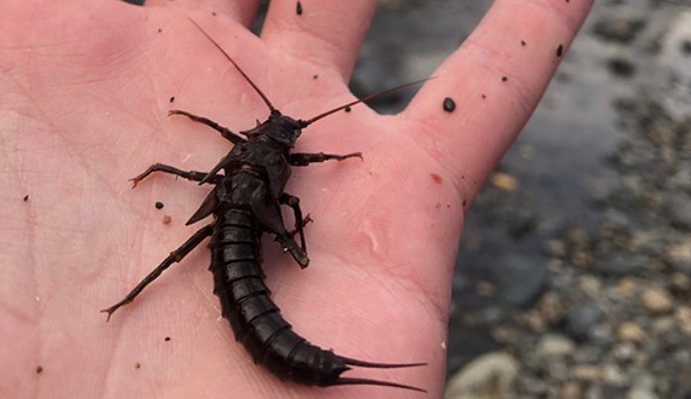
Opportunities
I got to spend most of my Friday afternoons getting hands on experience in the garden with Daniel.
Macroinvertebrate sampling for water quality with Jacob.
Snorkeling in the Mad River to count fish population.
Notes:
stonefly

Slide 11
Thank You!
Any Questions?

